Slide 1
Introduction to Docker
Revolutionizing Software Development and Deployment

Slide 2
Agenda
Overview of Docker
Key Concepts
Docker Components
Docker Images and Containers
Dockerfile
Basic Docker commands
Use Cases
QnA

Slide 3
Introduction to Docker
Docker is like a virtual box that holds everything a piece of software needs to run.
It makes it simpler for developers to build, share, and run applications, making the development and deployment process more efficient and consistent.

Slide 4
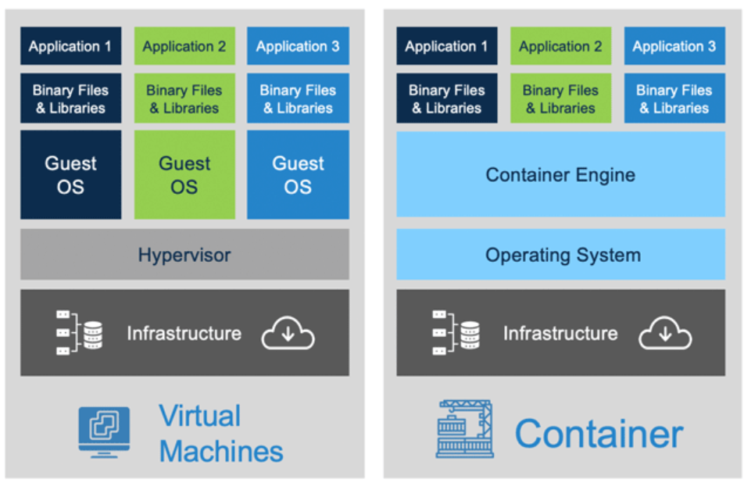
Key Concepts
VM vs Containers

Slide 5
Containerization
Containerization is a lightweight form of virtualization that allows developers to package applications and their dependencies, along with configuration files and runtime environments, into a single, isolated unit called a container.
Containers provide a consistent and reproducible environment for applications to run, regardless of the underlying infrastructure.

Slide 6
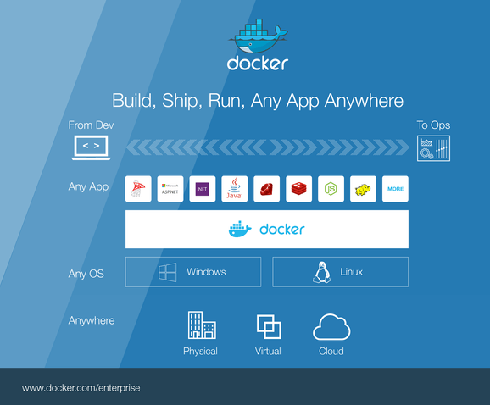
BUILD, SHIP and RUN any apps anywhere

Slide 7
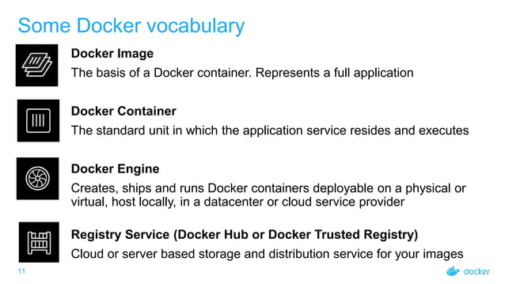
Some Docker Components

Slide 8
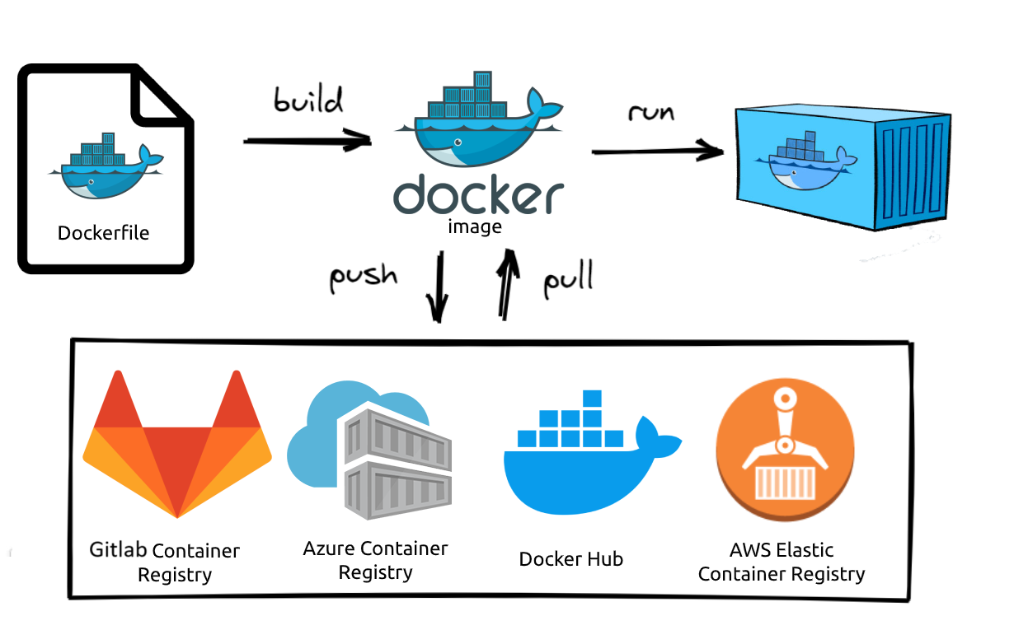
DockerFILE, Docker Image, Docker Container

Slide 9
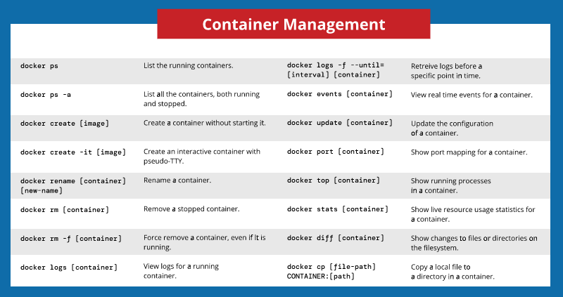
Basic docker commands

Slide 10
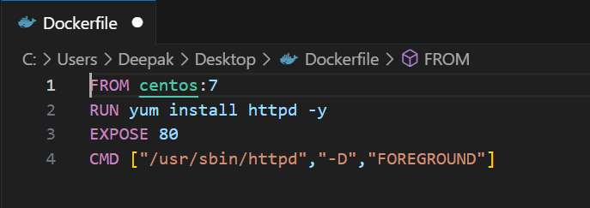
Sample Dockerfile
A Dockerfile is a script or a configuration file used to build a Docker image.

Slide 11
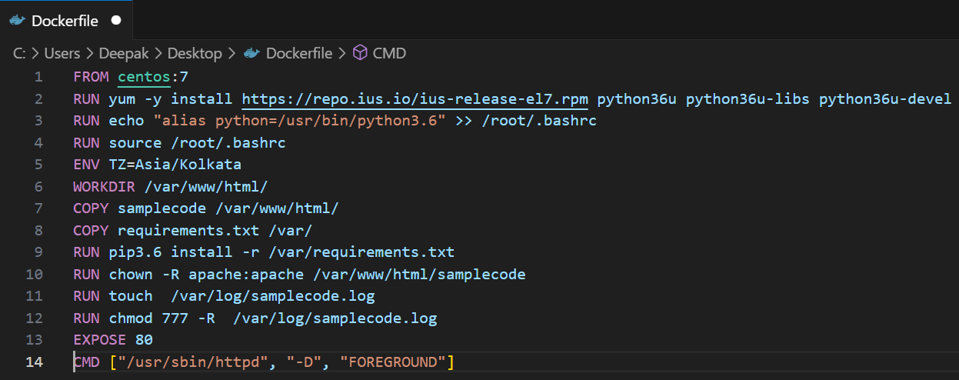
Dockerfile components
FROM – Name of base image
RUN – It executes commands on top of image
COPY – It helps to copy files and directory from base os to image
ENV - to set any environment variable
WORKDIR – this set the working directory where RUN COPY ADD works
CMD – default command to run when container starts

Slide 12
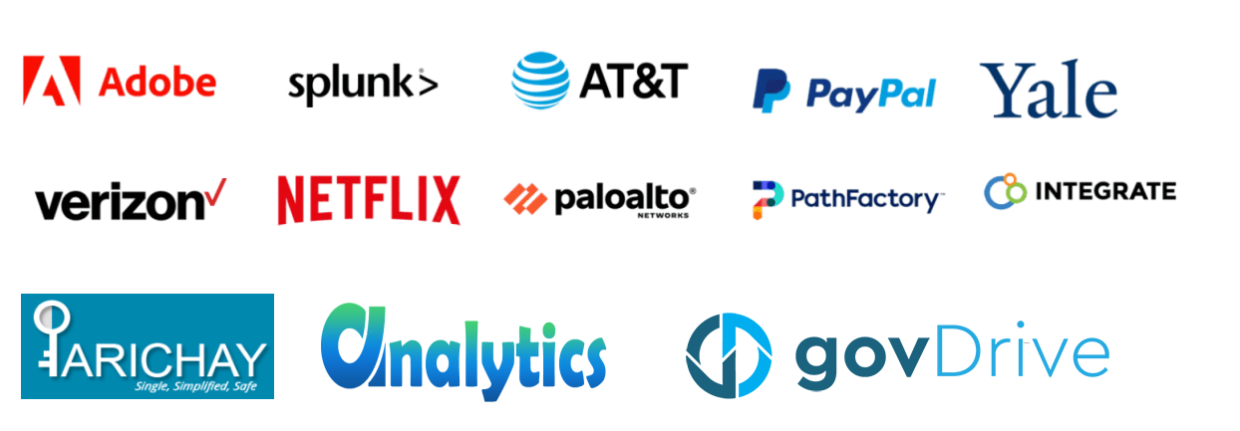
Use cases

Slide 13
Any queries ?

Slide 14
Thank YOu

